Slide 1
SQL 1
By: DSU Team

Slide 2
Apa itu SQL?
SQL singkatan dari Structured Query Language
SQL memungkinkan Anda mengakses dan memanipulasi database
Apa yang Bisa SQL lakukan?
SQL dapat mengeksekusi query terhadap database
SQL dapat mengambil data dari database
SQL dapat menyisipkan catatan dalam database
SQL dapat memperbarui catatan dalam database
SQL dapat menghapus catatan dari database

Slide 3
Buat Tabel
CREATE TABLE table_name(
column1 datatype,
column2 datatype,
column3 datatype,
.....
columnN datatype,
);

Slide 4
Menginput data
Cara 1
INSERT INTO TABLE_NAME (column1, column2, column3,...columnN)
VALUES (value1, value2, value3,...valueN);
Cara 2
INSERT INTO TABLE_NAME VALUES (value1,value2,value3,...valueN);

Slide 5
Tipe data

Slide 6
Numerik
smallint | -32768 to +32767
integer | -2147483648 to +2147483647
bigint | -9223372036854775808 to 9223372036854775807
real | 1E-37 to 1E+37
double precision | 1E-307 to 1E+308
smallserial | 1 to 32767
serial | 1 to 2147483647
bigserial | 1 to 9223372036854775807

Slide 7
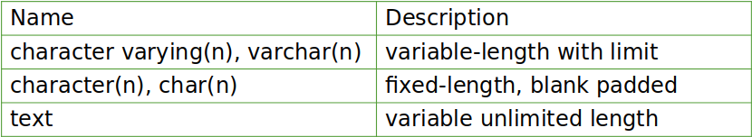
Character
Boolean
Name | Description
boolean | state of true or false

Slide 8
Time
Name | Description
timestamp [(p)] [without time zone ] | both date and time (no time zone)
TIMESTAMPTZ | both date and time, with time zone
date | date (no time of day)
time [ (p)] [ without time zone ] | time of day (no date)
time [ (p)] with time zone | times of day only, with time zone
interval [fields ] [(p) ] | time interval

Slide 9
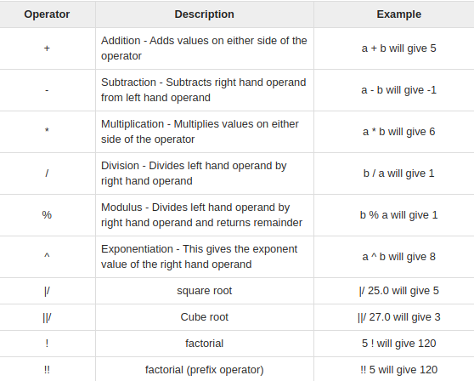
Math Operation

Slide 10
Exercise
CREATE TABLE COMPANY(
ID INT ,
NAME TEXT ,
AGE INT ,
ADDRESS CHAR(50),
SALARY REAL,
JOIN_DATE DATE
);

Slide 11
Exercise
INSERT INTO COMPANY (ID,NAME,AGE,ADDRESS,SALARY,JOIN_DATE) VALUES (1, 'Paul', 32, 'California', 20000.00,'2001-07-13');
INSERT INTO COMPANY (ID,NAME,AGE,ADDRESS,JOIN_DATE) VALUES (2, 'Allen', 25, 'Texas', '2007-12-13');
INSERT INTO COMPANY (ID,NAME,AGE,ADDRESS,SALARY,JOIN_DATE) VALUES (3, 'Teddy', 23, 'Norway', 20000.00, DEFAULT );
INSERT INTO COMPANY VALUES (4, 'Mark', 25, 'Rich-Mond ', 65000.00, '2007-12-13' ), (5, 'David', 27, 'Texas', 85000.00, '2007-12-13'), (6, 'Alex', 27, 'Silicon-Valley', 31000.00,'2003-01-01'), (7, 'Raul', 22, 'New-York', 23000.00,'2005-05-13'),(8, 'Paul', 24, 'Houston', 20000.00,'2008-07-14'), (9, 'James', 44, 'Norway', 5000.00,'2007-12-13'),(10, 'James', 45, 'Texas', 5000.00,'2007-12-13');

Slide 12
Mengupdate data
UPDATE table_name
SET column1 = value1, column2 = value2...., columnN = valueN
WHERE [condition];

Slide 13
Exercise
UPDATE COMPANY SET SALARY = 15000 WHERE ID = 3;
UPDATE COMPANY SET ADDRESS = 'Texas', SALARY=20000;

Slide 14
Menghapus Data
DELETE FROM table_name
WHERE [condition];

Slide 15
Exercise
DELETE FROM COMPANY WHERE ID = 2;
DELETE FROM COMPANY;

Slide 16
Menarik data
Cara 1
SELECT column1, column2, columnN FROM table_name;
Cara 2
SELECT * FROM table_name;

Slide 17
Exercise A (isi di Jupyter)
SELECT * FROM COMPANY
SELECT ID, NAME, SALARY FROM COMPANY

Slide 18
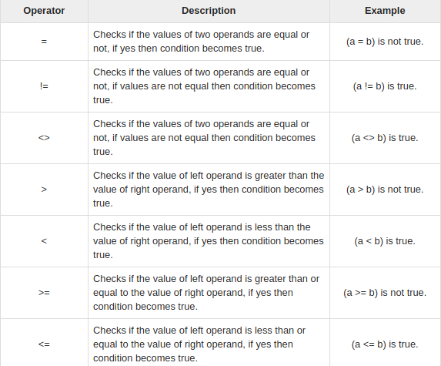
Comparison Operator

Slide 19
Memfilter Data
Cara 1
SELECT column1, column2, columnN
FROM table_name
WHERE [CONDITION | EXPRESSION];
Cara 2
SELECT column1, column2, columnN
FROM table_name
WHERE [search_condition]

Slide 20
Exercise B (isi di Jupyter)
SELECT * FROM COMPANY WHERE SALARY = 20000;
SELECT * FROM COMPANY WHERE AGE >= 25 AND SALARY >= 65000;
SELECT * FROM COMPANY WHERE AGE = 25 OR AGE =27;
SELECT * FROM COMPANY WHERE AGE IN ( 25, 27 );
SELECT * FROM COMPANY WHERE AGE NOT IN ( 25, 27 );

Slide 21
Memfilter Data (LIKE)
SELECT FROM table_name
WHERE column LIKE '%XXXX%'
SELECT FROM table_name
WHERE column LIKE '_XXXX_'

Slide 22
Exercise C (isi di jupyter)
SELECT * FROM COMPANY WHERE NAME LIKE “A%';
SELECT * FROM COMPANY WHERE name LIKE '%l%';
SELECT * FROM COMPANY WHERE NAME LIKE 'Alle_';
SELECT * FROM COMPANY WHERE NAME LIKE '_lle_';

Slide 23
Membatasi penarikan data
SELECT column1, column2, columnN
FROM table_name
LIMIT [no of rows]

Slide 24
Exercise D (isi di jupyter)
SELECT * FROM COMPANY LIMIT 3;

Slide 25
Mengurutkan Data
SELECT column-list
FROM table_name
[ORDER BY column1, column2, .. columnN] [ASC | DESC];

Slide 26
Exercise E (isi di jupyter)
SELECT * FROM COMPANY ORDER BY AGE ASC;
SELECT * FROM COMPANY ORDER BY NAME DESC;

Slide 27
Mencari nilai unik data
SELECT DISTINCT column1, column2,.....columnN
FROM table_name

Slide 28
Exercise F (isi di jupyter)
SELECT DISTINCT name FROM COMPANY;

Slide 29
Menggabungkan data
SELECT column-list
FROM table_name
GROUP BY column1, column2....columnN

Slide 30
Exercise G (isi di jupyter)
SELECT NAME, SUM(SALARY) FROM COMPANY GROUP BY NAME;

